Slide 1



A
CASE STUDY
An in-depth Product Teardown & Content Analysis

Slide 2






Understanding Netflix's Data Landscape
OTT platforms like Netflix generate massive viewer and content data
Managers face challenges making sense of this complexity
Visualization tools like Power BI help decode content performance
Our goal: turn data into actionable strategy insights

Slide 3





16+
CC
Project Scope and Key Research Questions
- Used Netflix TV Shows & Movies dataset from Kaggle
- Created Power BI dashboards to answer questions:
Content release trends
Top-performing genres
Runtime vs. engagement
TV shows vs. movies
- How visualizations support decision-making

Slide 4
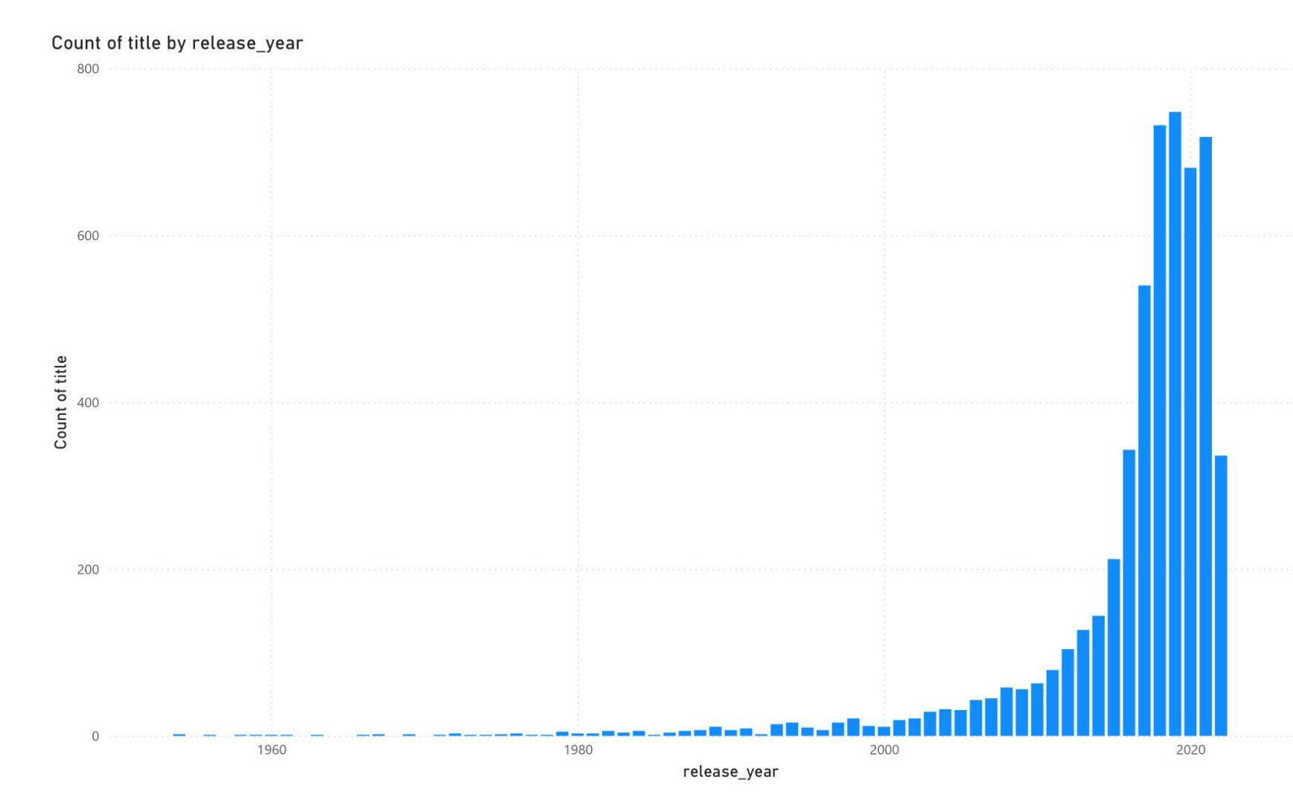
Content Titles Released Over Time
Steady rise in Netflix content since 2010
Sharp growth after 2015 reflects global expansion
Indicates investment in original content

Slide 5
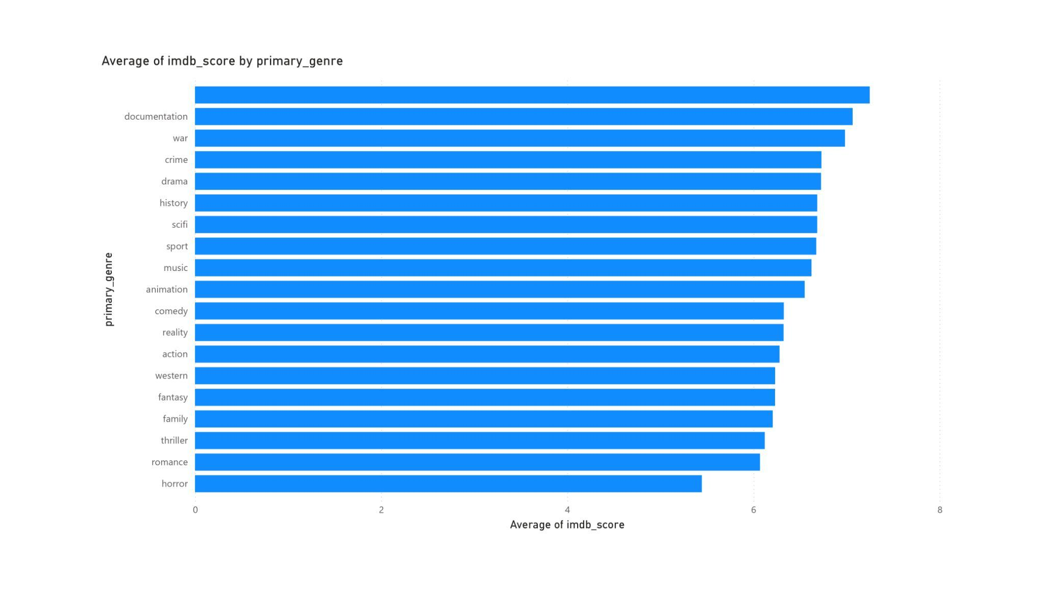
Average IMDb Score by Genre
Highest ratings: Documentary, War, Drama
Lowest: Horror, Romance
Helps identify high-performing genres for future production

Slide 6
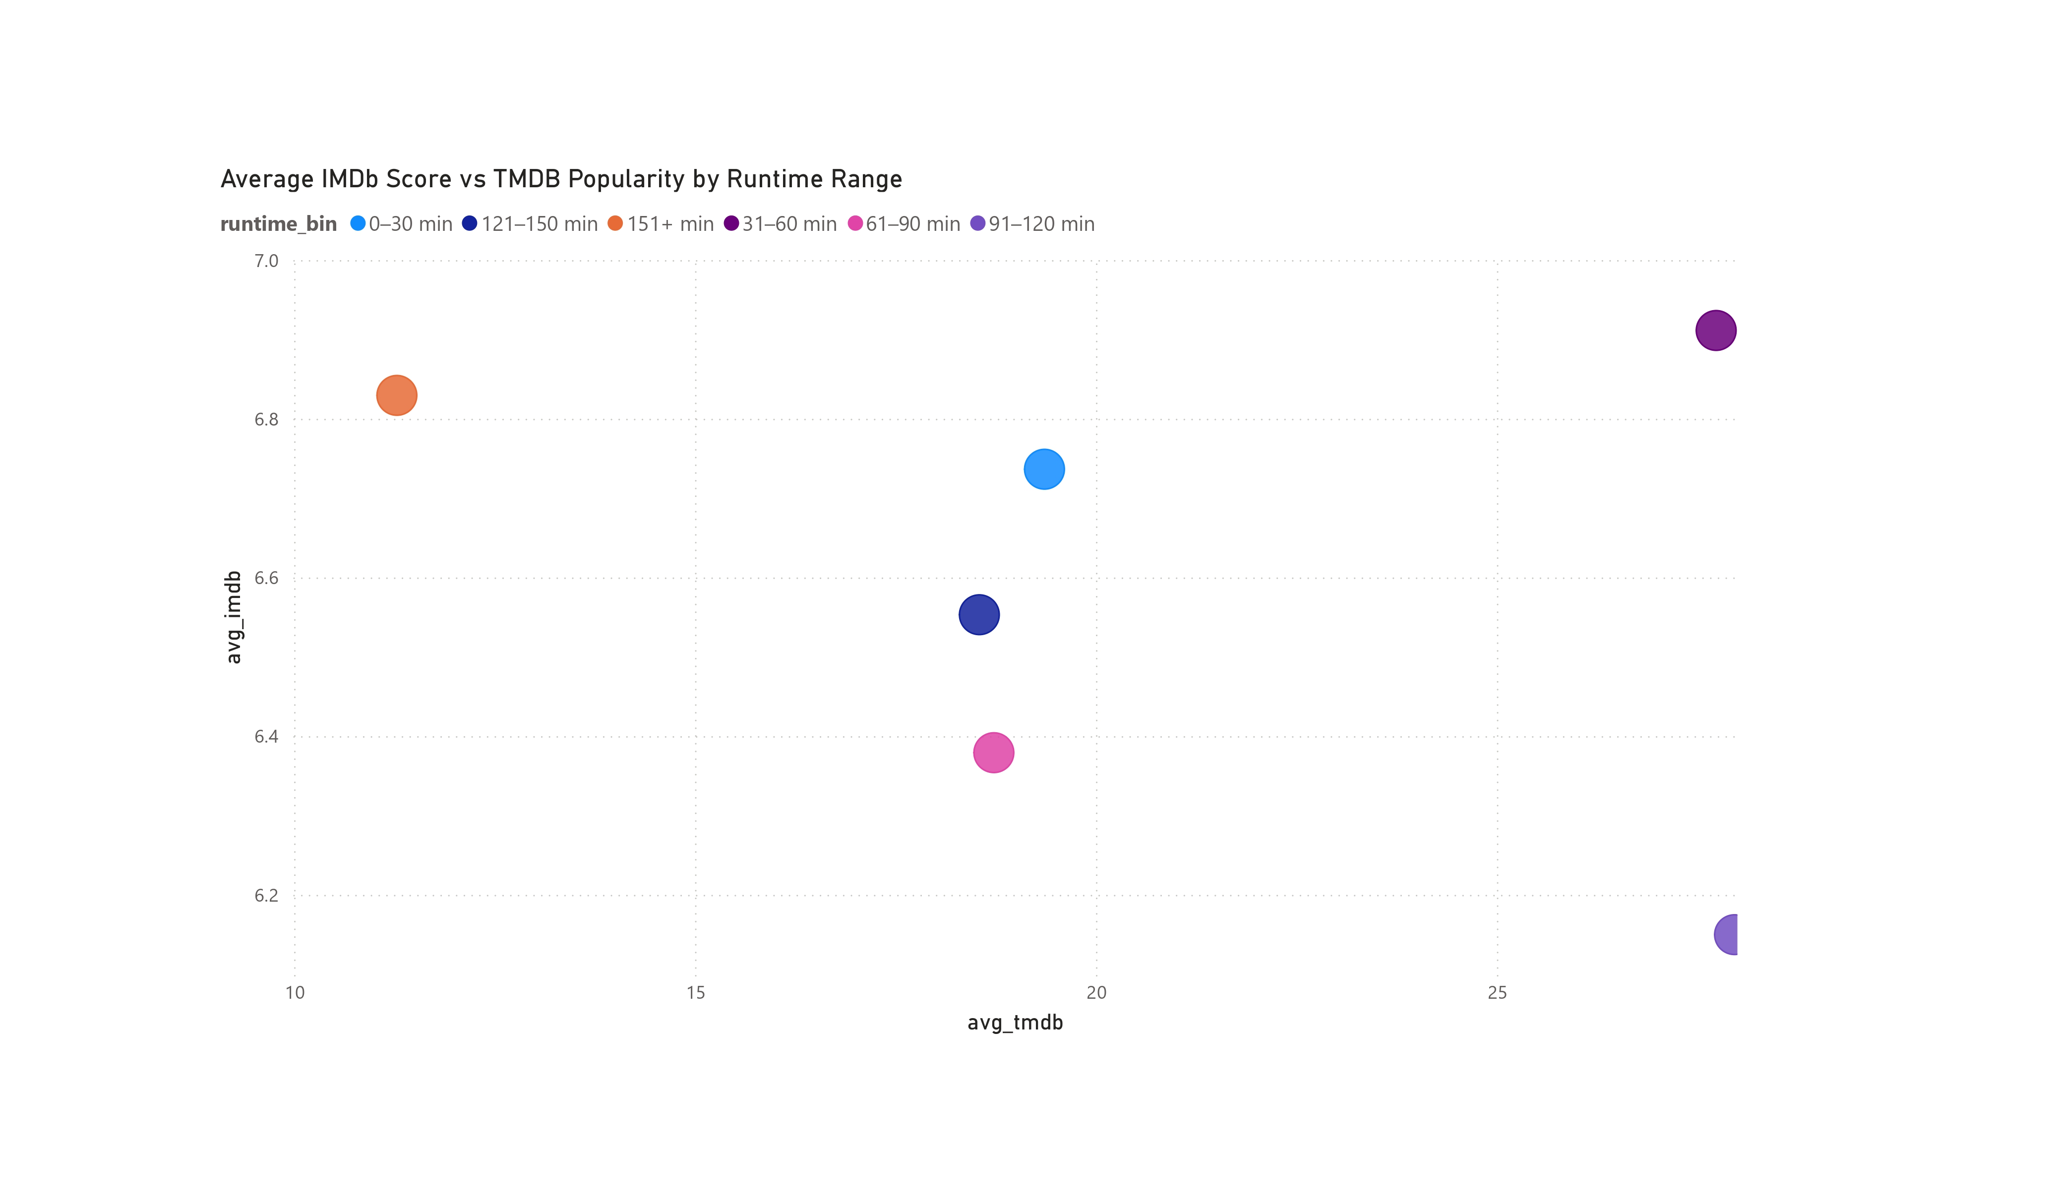
Runtime vs Engagement
Runtime bins (e.g., 90–120 min) show peak IMDb ratings
Audience engagement highest for mid-length titles
Helps guide optimal runtime for new releases

Slide 7
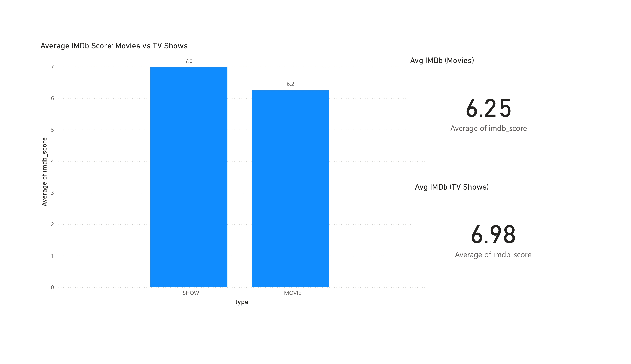
TV Shows vs Movies Analysis
TV shows average higher IMDb scores than movies
Stronger engagement over multiple episodes
Suggests greater ROI in episodic content

Slide 8





16+
CC
IMPLICATIONS
High-rated genres: Documentary, War, Drama
Runtime sweet spot: 90–120 minutes
TV shows outperform movies in audience ratings
Episode 1
Episode 2
Episode 3
Episode 4

Slide 9






Recommendations for Netflix
1
3
8
10
13
15
17
Prioritize high-performing genres
Optimize movie length to viewer sweet spot
2
4
9
11
14
16
18
19
21
23
25
27
29
4
Invest more in episodic content
Use dashboards for ongoing content analysis
20
22
24
26
28
30
5
6
8
10
12
20
9
16
21
23
25
7
9
11
13
11
26
18
22
24
26
That’s all for now

Slide 10
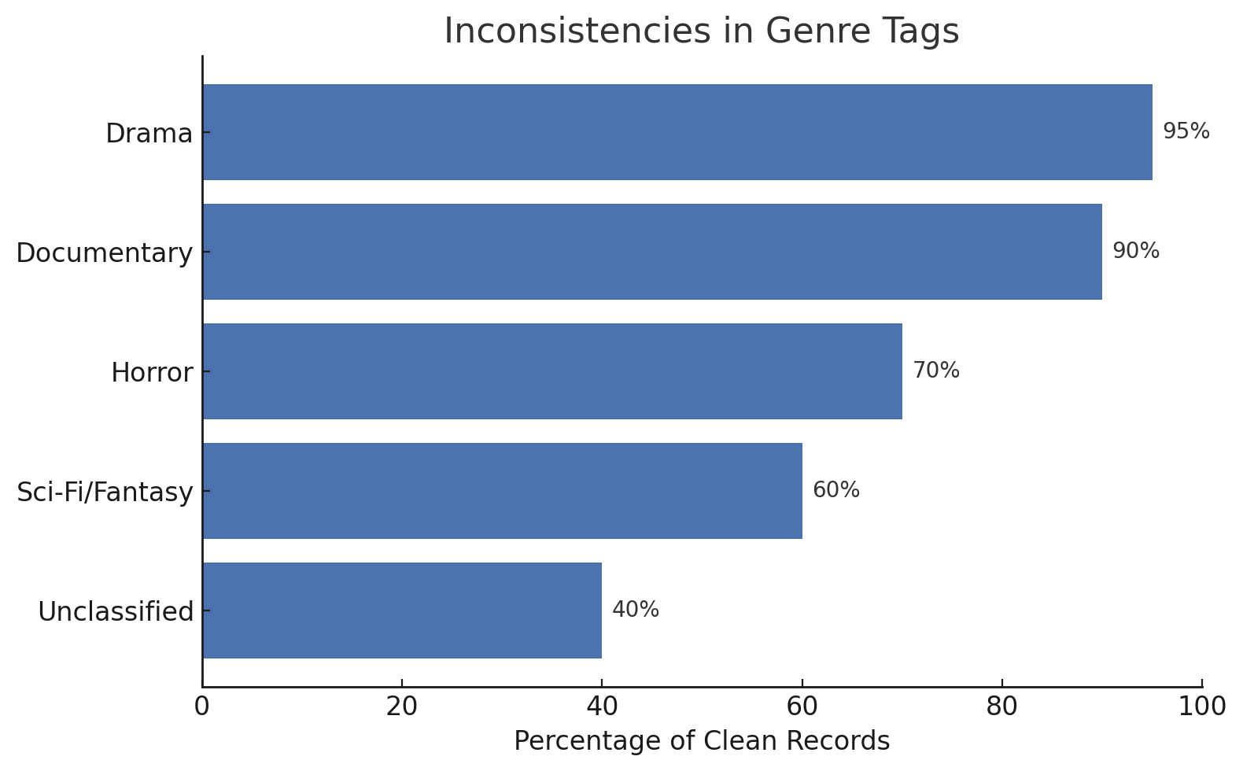
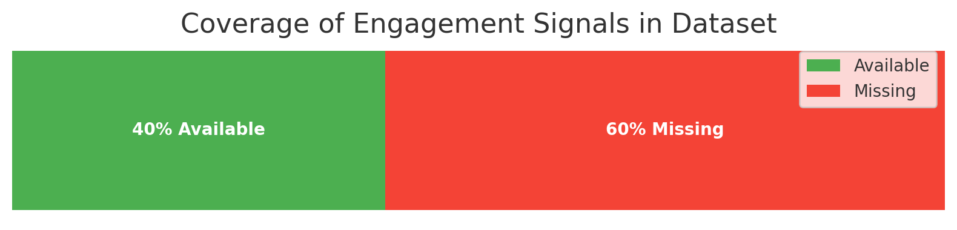
Limitations
Ratings are subjective and may not reflect all audiences
Genre tags inconsistent across titles
No actual viewership numbers (only IMDb & TMDB proxies)

Slide 11
CONCLUSION
2
Visualization uncovers strategic insights
1
Power BI helped simplify complex data
3
Supports real-time, data-backed decision-making at Netflix

